Slide 1
XG BOOST ALGORITHM

Slide 2
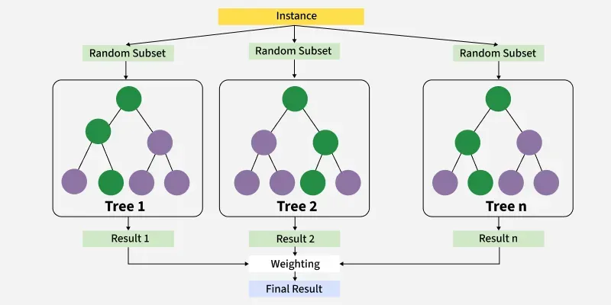

Slide 3
XG BOOSTING
Stands for:
eXtreme Gradient Boosting.
XGBoost is a powerful iterative learning algorithm based on gradient boosting.

Slide 4
PROCESS
Step 1: The algorithm makes an initial prediction - the average value of the target column.
Step 2: It calculates the residuals (the gap between actual values and initial predictions).
Step 3: A new decision tree is trained to predict these residuals and correct the mistakes made by the previous tree.

Slide 5
Thank You!

